Slide 1

PRESENTATION ON CHEMICAL BONDING -BY VANSHIKA SINGLA

Slide 2
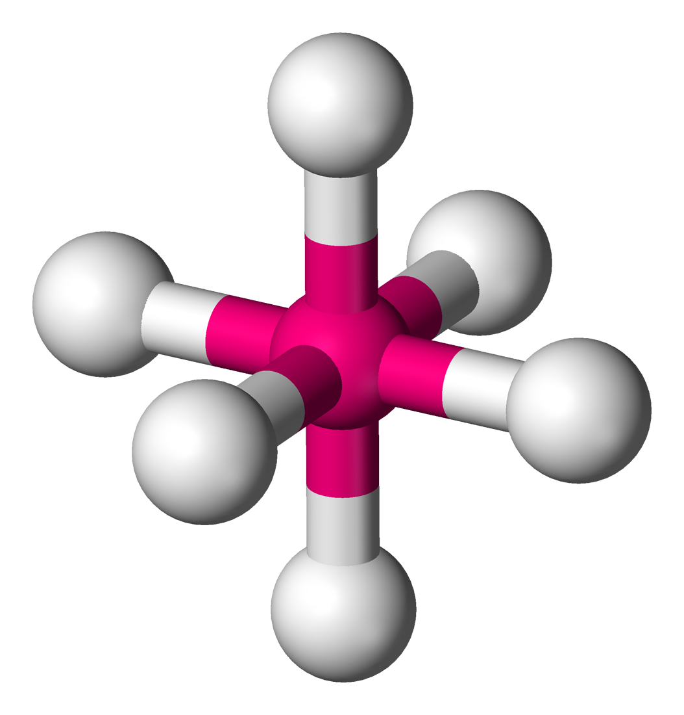
CFT IN OCTAHEDRAL
This Photo by Unknown Author is licensed under CC BY-SA

Slide 3
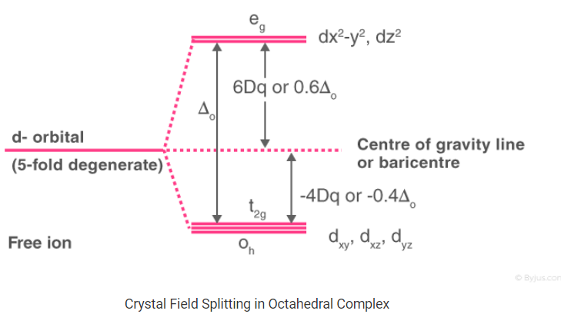

Slide 4
CFT IN TETRAHEDRAL

Slide 5
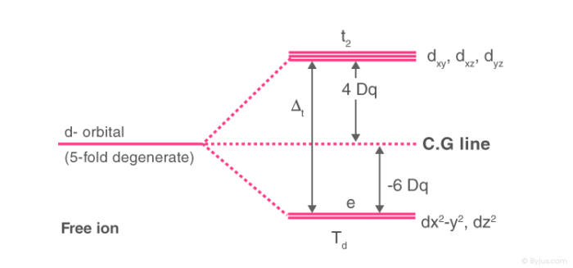
Crystal Field Splitting in Tetrahedral Complexes
Δ_{t} = magnitude of crystal field splitting where t stands for tetrahedron.
_{Why is it so?}

Slide 6

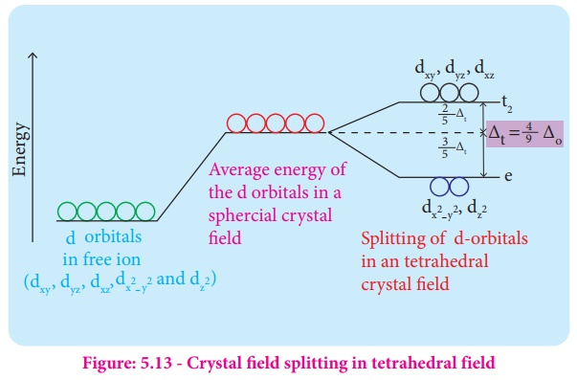
What are tetrahedral complexes? In a tetrahedral complex, there are four ligands attached to the central metal. The d orbitals also split into two different energy levels. The top three consist of the d_{xy}​, d_{yz}​, d_{xz}​ orbitals. The bottom two consist of the d_{x2−y2}​and d_{z2}​ orbitals. The reason for this is due to poor orbital overlap between the metal and the ligand orbitals. The t_{2g} orbitals are closer to approach of ligands than e_{g} orbits hence t_{2g} is at higher energy level and e_{g} at lower energy level.

Slide 7
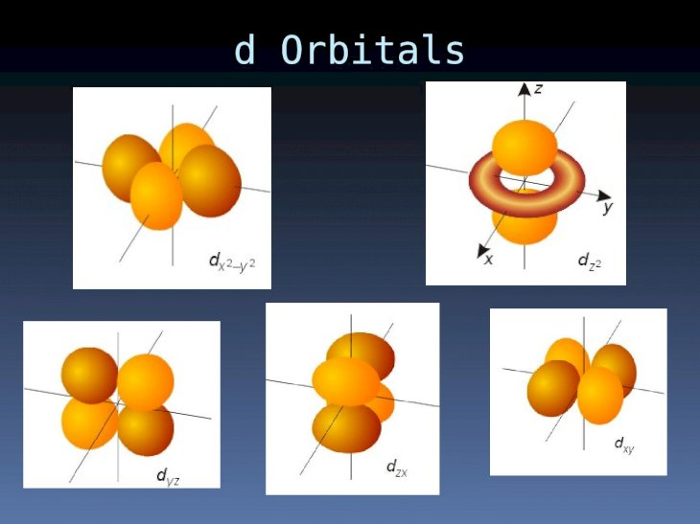

Slide 8
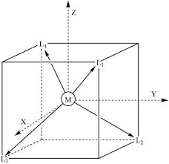
The d_{xy}, d_{yz} and d_{zx} orbitals are very close to ligands so there will be some repulsion between ligands and electrons whereas d_{z2} , d_{x2-y2} are far from ligands so there will be very very less repulsion hence the d_{xy}, d_{yz}, d_{zx} orbitals have higher energy than d_{z2} and d_{x2-y2} orbitals. The gap between the d_{xy}, d_{yz}, d_{zx} and d_{z2}, d_{x2-y2} orbitals is less as compared to octahedral due to very less overlapping between orbitals and ligands.

Slide 9
Tetrahedral complexes are favoured by:
Large and bulky ligands.
Weak field ligands
Where central atom has low oxidation state.
Where the electronic configuration of the central atom d⁰, d⁵, d¹⁰ as there is no CFSE.
Where the loss of CFSE is small as in d¹, d², d⁶, d⁷.

Slide 10
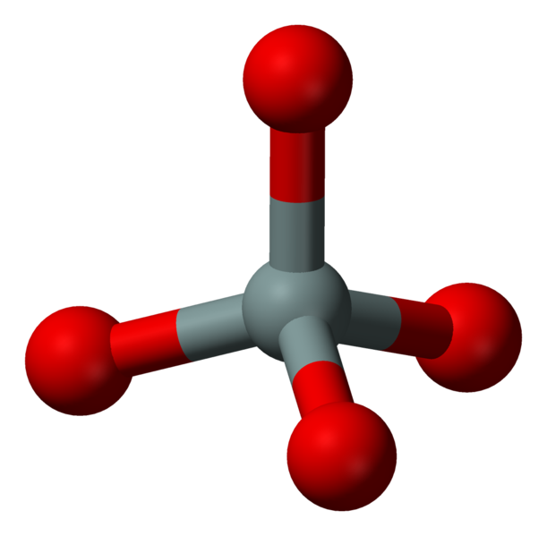
Why ?
In tetrahedral complex there are only four
ligands hence crystal field splitting may
be only 2/3 the magnitude of crystal field
In octahedral complex.
The direction of orbitals in tetrahedral
complex does not coincide with the
direction of ligands and this effect further
reduces the crystal field splitting by
another 2/3 value.
This Photo by Unknown Author is licensed under CC BY-SA

Slide 11
CFSE
(IN TETRAHEDRAL)
When the ligand approach central metal atom there is repulsion between ligand electrons and d orbital electrons of central metal atom.
When the ligand approaches central metal atom there is splitting of d orbital in e_{g} and t_{2g} sets.
The gap between these two sets e_{g} and t_{2g} is called energy gap or Crystal Field Stabilization Energy.

Slide 12
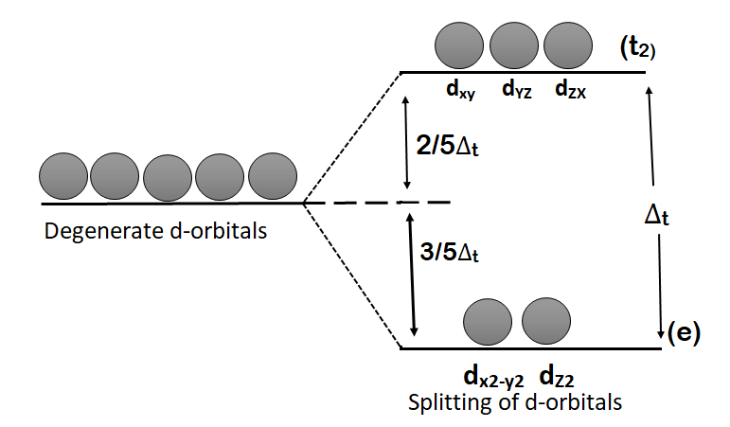
The energy difference between t₂ and e_{g} sets called Δ_{o} is proportional to crystal field strength of ligands that is how strongly ligand electrons repel metal electrons.
The energy of each of two low energy levels e_{g} is decreased by 3/5 above their energy in spherical field, while the energy of each of three high energy orbital t_{2g} is increased by 2/5 below their energy in spherical field.

Slide 13
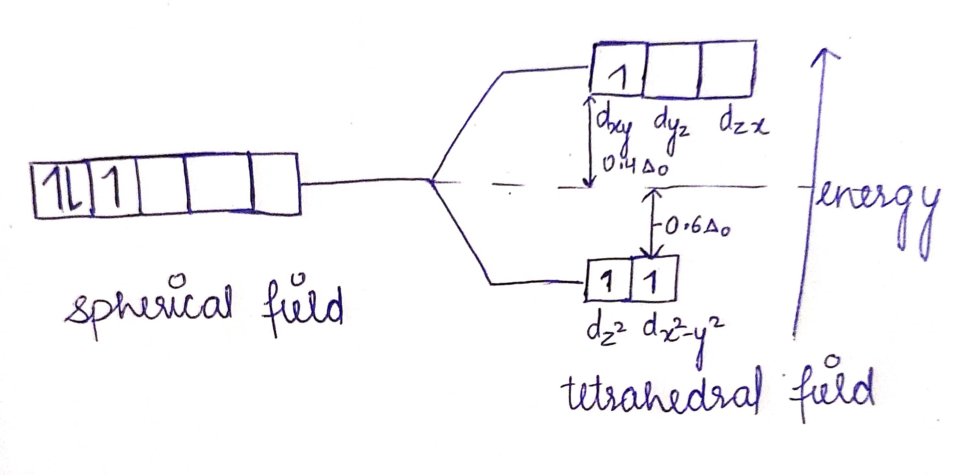
CALCULATION OF CFSE IN TETRAHEDRAL COMPLEXES
CFSE= (-3/5e_{g} + 2/5t_{2g})*4/9 Δ_{o}
Silver
For a d³ tetrahedral configuration, the Crystal Field Stabilization Energy is −0.8Δ_{tet}
CFSE = -0.8 x 4/9 Δ_{o} = -0.355 Δ_{o}.
Cross
Red

Slide 14
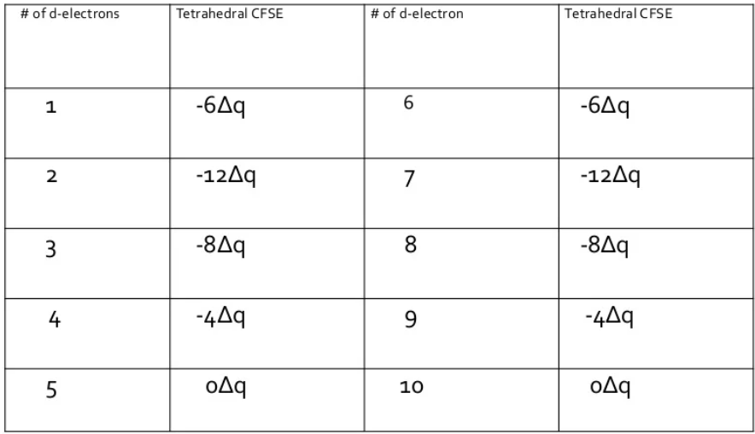

Slide 15
FACTORS AFFECTING CRYSTAL FIELD STABILIZATION ENERGY:
NATURE OF LIGANDS
NATURE OF METAL CATION
QUANTUM NUMBER
GEOMETRY OF COMPLEXES

Slide 16
COMPARISON BETWEEM TETRAHEDRAL AND OCTAHEDRAL COMPLEXES:

Slide 17
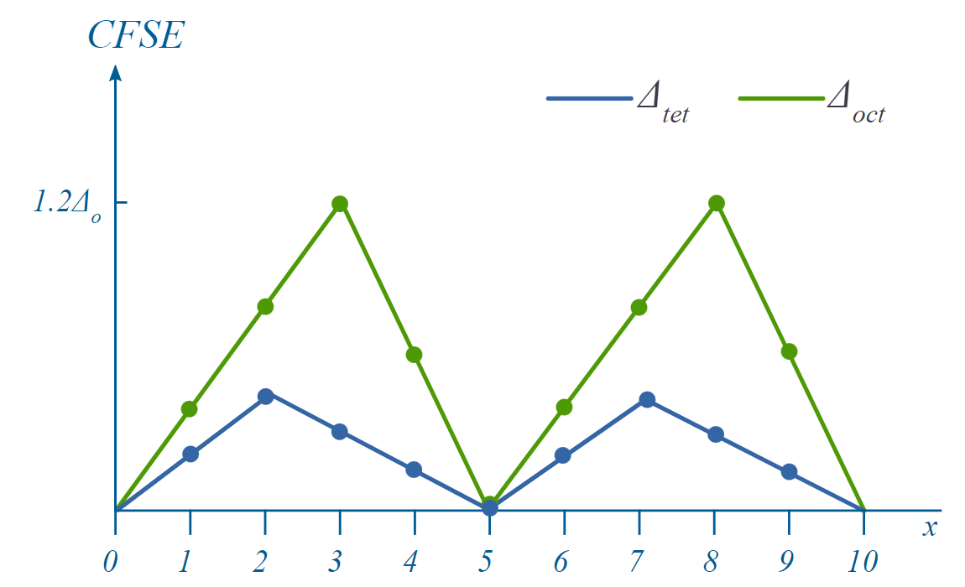
For d¹ there's only a small gap between the octahedral and tetrahedral lines, whereas at d³ and d⁸ there's a big gap. However, for d⁰, d⁵ high spin and d¹⁰, there is no CFSE difference between octahedral and tetrahedral.​
GRAPHICAL COMPARISON

Slide 18

One-sentence headline stating the main takeaway message for the slide; no longer than two lines

